Slide 1

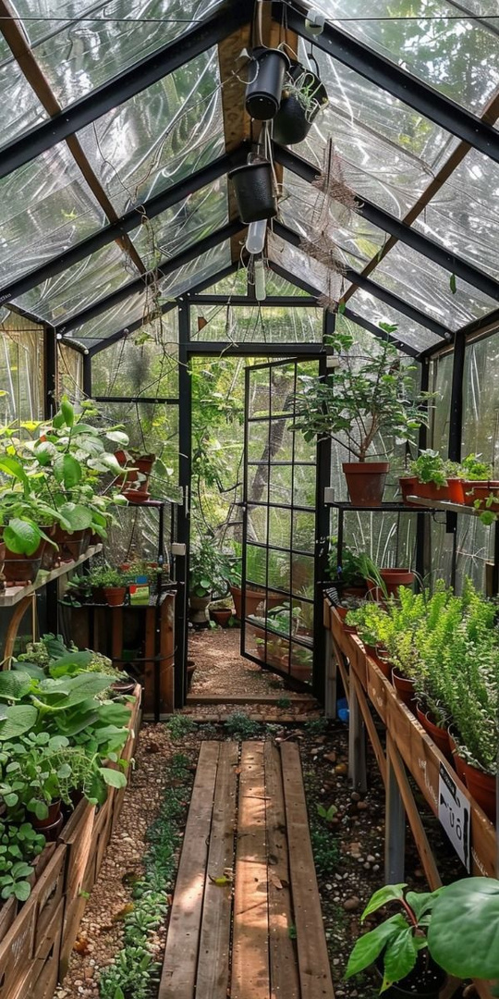


IT1040 - Fundamentals of Computing
GREENHOUSE
AUTOMATION
SYSTEM
Group P12-19

Slide 2

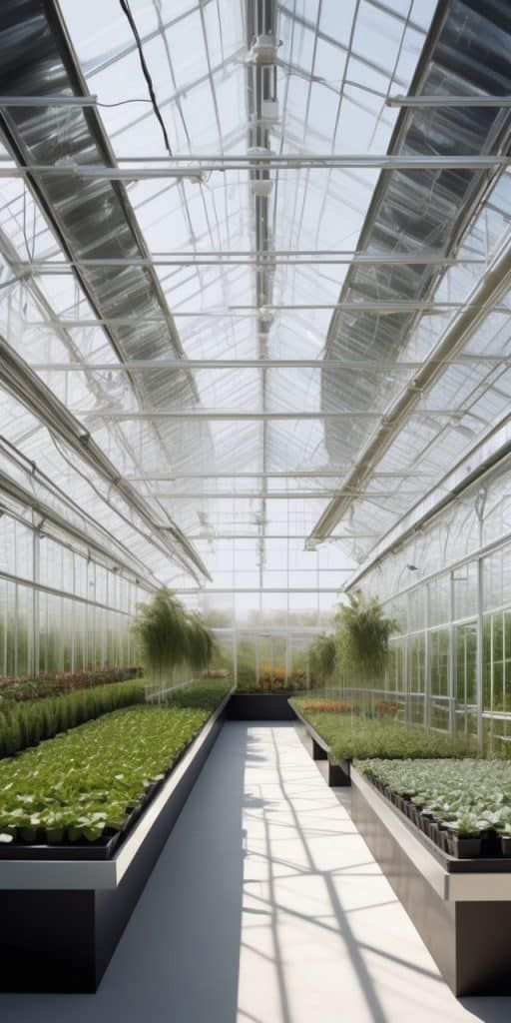
Content
01
Background
02
Problems and Motivation
03
Aims and Objectives
04
System Diagrams
05
Methadology
06
Evaluation
07
Our Team

Slide 3







Background
01
02
Sensors indicate the parameters in real-time
Creating algorithms and program the microcontrollers.
03
04
Mobile application to intract with the user.
Implement the hardware components and test the prototype.

Slide 4







Problems
Inefficient water supply
Over-watered
soil
Lower
light -intensity
Unnecesary
heating

Slide 5





Motivations
Increase the productivity
Adaptability to
Climate changes
Maintain the
water usage
Cost
Saving

Slide 6





Aim
Fully Automated Greenhouse System
Unnecesary
heating

Slide 7



Objectives
Measure environmental status in real-time
Automated water valve
Automated Lightning System
Unnecesary
heating

Slide 8
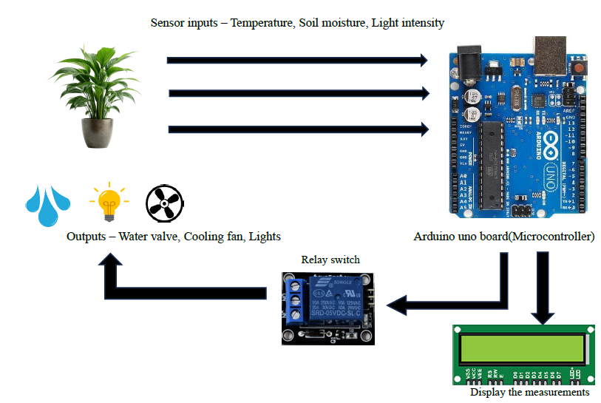
System Diagram

Slide 9
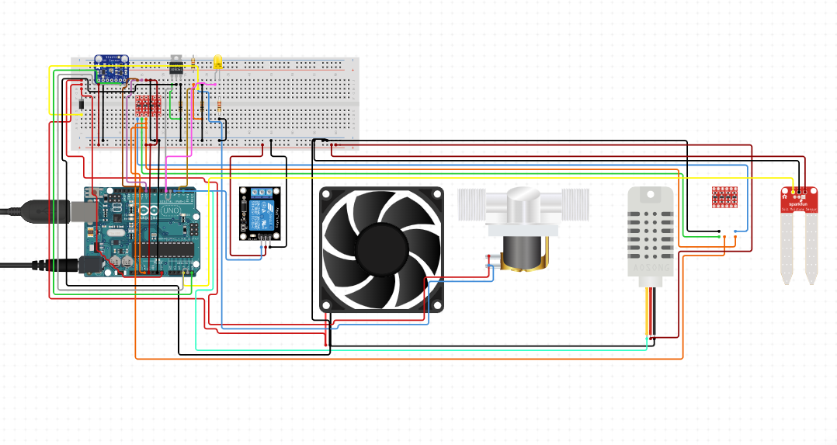
Circuit Diagram

Slide 10




Methodology
Feasibility Study and requirement analysis
Selecting components and Calibration
Hardware design & Software development
Test and debug

Slide 11




Components
Sensors
Microcontroller
Soil moisture Sensor
Temperature Sensor
Light Sensor
Arduino Uno Microcontroller board based on the ATmega328P
Output devices
User Interface
Automated Water valve
Automated cooling fan
Automated light System
Arduino IoT Remote phone application

Slide 12




Evaluation
Cost
Effectiveness
Environmental
Control efficiency
Real-time
Sensor Accuracy
Resource
Comsumption
Reliablity
and stability

Slide 13
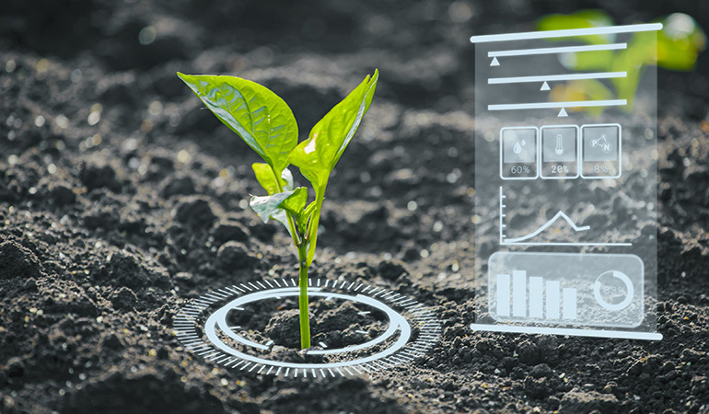
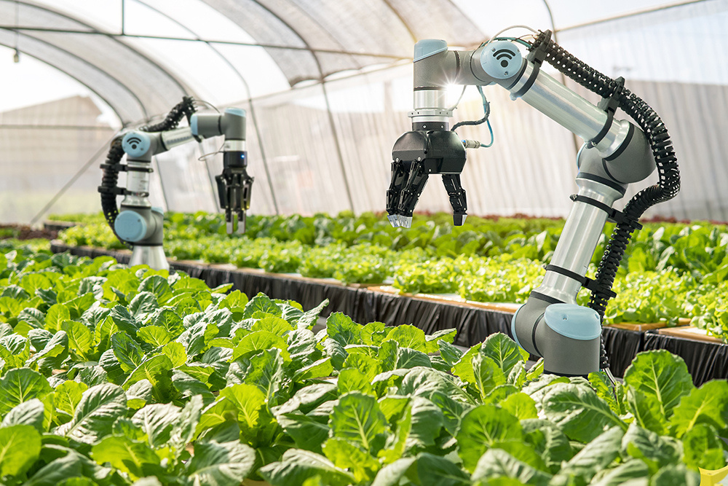

THANK YOU

